Slide 1
PEGA Decisioning Essentials

Slide 2
Agenda – Session 8
Score Card Models

Slide 3
Score card Models
Scorecards are mathematical models that are calculated based on set of conditions and combiner score
Scorecard = CONDITIONS + COMBINER.
Scorecard rules are referenced in decision strategies through the scorecard component. Learn how to create scorecard-specific rules to derive decision results from several factors.
These conditions are customer properties or expression based on properties.
Output of score card =Raw Score & Segment Result

Slide 4
Score card Models - Creation
The bank wants to automate the credit card requests process by analyzing a customer's credit score based on customer profile information and categorizing it into the right credit score level using a scorecard.
Now, lets say the bank defined the credit score levels as HIGH, LOW, MEDIUM
Business also defines a range between which this level is defined.
LOW – Not qualified for low
MEDIUM – Need manager approval
HIGH – Instantly eligible for CREDIT CARD.

Slide 5
Score Card Models
Inorder to calculate the credit score, the business defines the predictors or the conditions based on which we define the credit score.
Let us say the 3 main factors or conditions for calculating these are
Age
Income
HasCards.
Let us understand the business criteria for the above conditions and derive the score.

Slide 6
Score card example
x
If the age is between 18 – 30 , A Score of 60 is assigned.
If age 30-50, score is 80
If the age is between 50 – 60, A Score of 30 is assigned
If the income is 50k above, A Score of 80 is assigned
If the income is between 30k – 50k, A score of 60 is assigned
If the income is less than 30k, A Score of 30 is assigned.
If the hascards = yes , A Score of 30 is assigned.
If the hascards = no, A Score of 80 is assigned

Slide 7
Score card Model
Now the Bank provides a chart for the credit score level and their respective ranges.
HIGH - > 200 – Instantly Eligible
MEDIUM – 150 – 200 – Approval Required
LOW - < 150 - Not Qualified
Lets say a customer with age 40, income of 50k per month and account type as gold
Falls as = 80+60+60 = 200 = MEDIUM – So it goes to approval after customer applies loan. Now the credit score is 200 and Segment result is Approval Required.

Slide 8
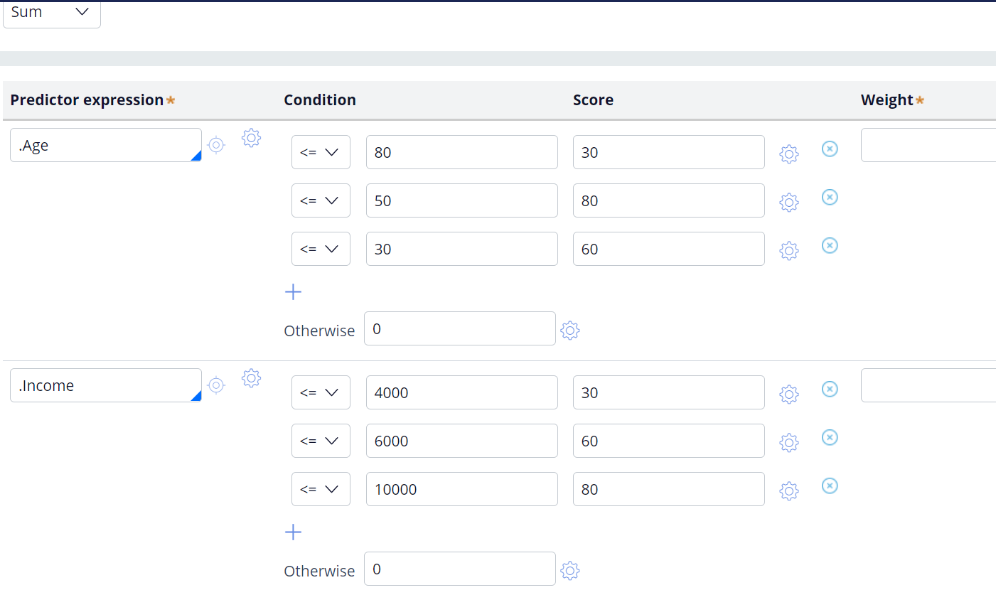

Slide 9
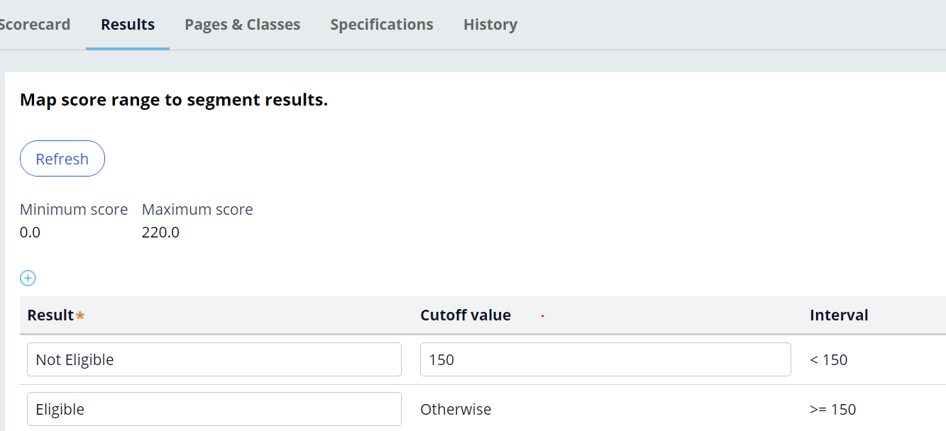
Score Card Results

Slide 10
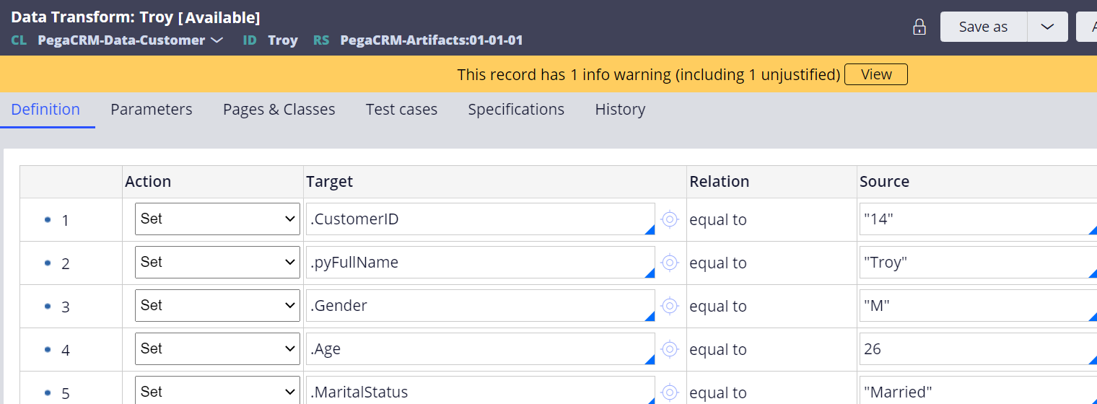
Run Strategy

Slide 11
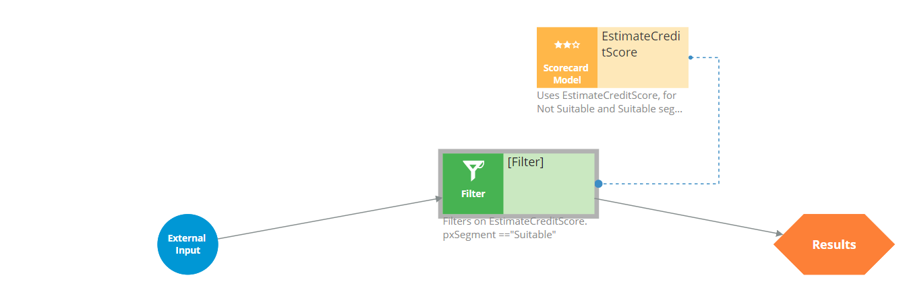
Score card result
Just add a score card model shape to the strategy and use the score card that u created and select it.
Now we need to display the credit card offers only to the customers whose segment result is “Suitable”
Score card output is stored in .pxSegment value, hence we can use the filter with the condition as
SCORECARDMODELName.pxSegment==“Suitable”
Notice the dotted component from the score card when it is refered from filter shape.
Now start testing with the customer personas using single case strategy.

Slide 12
Questions!

